Slide 1
Understanding Chest X-Ray Reading: Normal vs. Pathological Findings
Dr. Meghdad Ghasemi Gorji
Assistant Professor of Vascular and Endovascular Surgery
Vascularsurgery.ir
Dr.Meghdadghasemi

Slide 2
Overview of Chest X-Ray (CXR)
Definition: A Chest X-Ray is a radiographic technique used to create images of the thoracic region, including the heart, lungs, and surrounding tissues.
Purpose: It is primarily used to diagnose and monitor a variety of conditions affecting the chest, such as infections, tumors, and fluid accumulation

Slide 3
Role in Medical Diagnostics
First-line Imaging: CXR is often the initial imaging modality utilized in the evaluation of various symptoms, especially respiratory complaints.
Non-invasive and Quick: The procedure is relatively quick, does not require sedation, and provides immediate results, making it an essential tool in emergency and acute care settings

Slide 4
Common Indications for CXR
Respiratory Symptoms: Cough, dyspnea (shortness of breath), chest pain, fever.
Trauma: Evaluating for fractures and other injuries post-accident or fall.
Pre-operative Assessment: Ensuring lung health before surgery.
Monitoring Treatment: Evaluating progress in diseases like pneumonia or tuberculosis

Slide 5
Basic Anatomy Visible on CXR
Lungs:
Left Lung: Two lobes (upper and lower), cardiac notch.
Right Lung: Three lobes (upper, middle, and lower), generally larger and broader.
Heart:
Located in the midline, best seen on the PA view.
Examine size (normal heart size is less than 50% of the thoracic width).
Diaphragm:
Normally rounded; right dome is typically higher than the left due to the liver.
Look for flattening (indicative of COPD) or elevation (possible diaphragm paralysis).
Mediastinum:
Contains the heart, great vessels, trachea, esophagus, and thymus.
Should appear symmetric; widening can indicate pathologies (e.g., aortitis).
Hilum:
Region where bronchi, blood vessels, and lymphatics enter/exit the lungs.
Any asymmetry or pathological enlargement can indicate disease

Slide 6
Key Structures to Identify
Trachea:
Midline structure; deviations may suggest pathology (e.g., tension pneumothorax).
Bronchial Tree:
Visible on a good-quality CXR, helps assess for obstruction or infection.
Costophrenic Angles:
Should be sharp and well-defined; blunting can indicate pleural effusion.
Bony Structures:
Ribs, clavicles, and vertebrae; check for fractures or abnormalities.
Soft Tissues:
Look for mediastinal widths and abnormalities in the soft tissues surrounding the lungs

Slide 7
Chest X-Ray Views
Posteroanterior (PA):
Standard view; patient standing, provides clear visualization of the heart and lungs.
Lateral View:
Provides additional information about the depth of structures and can help visualize the posterior aspects of the lungs

Slide 8
Normal Chest X-Ray Characteristics
Overall Appearance
A normal CXR should display clear and unobstructed lung fields.
No significant opacities or abnormalities should be present.
Lungs
Visualization:
Lung fields should be uniformly aerated with no signs of consolidation, infiltrates, or masses.
Vascular Marking:
Normal pulmonary vessels can be seen but should not be engorged or obscured by opacities.
Costophrenic Angles:
Sharp and well-defined; there should be no blunting or signs of fluid accumulation.
Lobes:
Left lung (two lobes: upper and lower) and right lung (three lobes: upper, middle, and lower) should be clearly demarcated.

Slide 9
Heart
Size:
The cardiac silhouette should be less than 50% of the thoracic width in a PA view (normal cardiothoracic ratio).
Shape:
Should appear normal without any abnormal contours or enlargement.
Position:
Lies in the midline or slightly to the left; deviation may indicate pathology.
Diaphragm
Position:
The right diaphragm typically appears higher than the left (due to liver placement) but should not be flattened or elevated.
Curvature:
Should be smooth and rounded without focal abnormalities

Slide 10
Mediastinum
Width:
Should appear normal and symmetric; widening may suggest possible conditions like aortic aneurysms.
Trachea:
Centrally located; any deviation could be indicative of pathology.
Hilum
Symmetry:
Hilar structures (pulmonary vessels and lymph nodes) should be symmetric in size and position with no obvious enlargement or mass effects.

Slide 11
Bony Structures
Ribs and Clavicles:
Should be intact with no signs of fractures or lesions.
Vertebrae:
Alignment should be normal, with no signs of abnormalities.
Soft Tissues
Neck and Upper Borders:
Normal appearance of the soft tissues around the thorax and neck region.
No Extrathoracic Abnormalities:
Absence of soft tissue masses or other lesions in the visual field

Slide 12
Systematic Approach to CXR Interpretation
Utilize a structured approach:
Airways: Check for tracheal deviation.
Bones: Look for skeletal abnormalities.
Cardiac silhouette: Assess heart size and shape.
Diaphragm: Look for flattening or elevation.
Effusions: Check for fluid levels in pleural space.
FIELDS: Analyze lung fields for opacities or infiltrates

Slide 13
Normal CXR anatomy

Slide 14
Common pathology in chest x-ray

Slide 15
Pneumonia
Description: Infection leading to lung inflammation and consolidation.
CXR Appearance:
Homogeneous opacity (white areas) in lung fields, typically termed “consolidation.”
May also see air bronchograms (visible air-filled bronchi on a background of opaque alveoli).
Common Locations: Lower lobes are often involved, but pneumonia can occur anywhere

Slide 17
Pulmonary Edema
Description: Accumulation of fluid in the lungs, often due to heart failure.
CXR Appearance:
Enlarged heart silhouette (cardiomegaly).
Increased vascular markings (Kerley B lines) and peribronchial cuffing.
“Batwing” appearance with bilateral diffuse haziness.
Common Signs: Blunting of costophrenic angles due to pleural effusions in severe cases.

Slide 19
Pleural Effusion
Description: Excess fluid accumulation in the pleural space.
CXR Appearance:
Blunting of the costophrenic angles; meniscus sign may be there.
May present as large opacities if significant.
Requires lateral decubitus view or ultrasound for smaller amounts.
Types: Can be transudative or exudative based on underlying cause

Slide 21
Pneumothorax
Description: Air in the pleural space, causing lung collapse.
CXR Appearance:
Visible visceral pleura (thin, white line along the lung margin) with absent vascular markings beyond that line.
On upright films, there may be a visible pleural line and increased radiolucency (dark area) on the affected side.
Types: Can be spontaneous, traumatic, or tension pneumothorax

Slide 23
Rib fracture

Slide 24
Interstitial Lung Disease
Description: A group of diseases affecting the interstitium of the lungs.
CXR Appearance:
Reticular or nodular opacities, often bilateral.
Examples include idiopathic pulmonary fibrosis, sarcoidosis, and asbestosis.
Common Signs: Honeycombing or ground-glass opacities on high-resolution CT (not CXR).

Slide 25
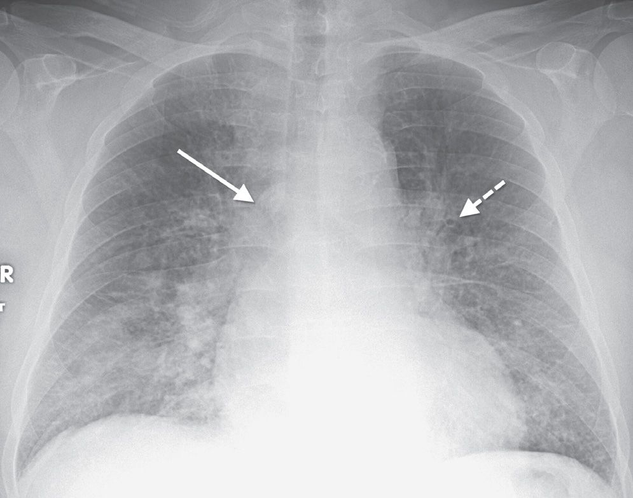

Slide 26
Lung Nodules or Masses
Description: Small abnormal growths in the lung tissue.
CXR Appearance:
Round opacities, greater than 3 cm is termed a mass.
Characteristics (e.g., calcification patterns) are essential for distinguishing benign from malignant lesions.
Follow-up: Often requires further imaging (CT) for characterization

Slide 28
Tuberculosis
Description: A contagious infection, primarily affecting the lungs.
CXR Appearance:
Apical cavitary lesions, often seen in reactivation TB.
Possible bilateral infiltrates, especially in miliary TB.
Common Signs: Ghon complex (primary TB infection) may appear as calcified nodules

Slide 29
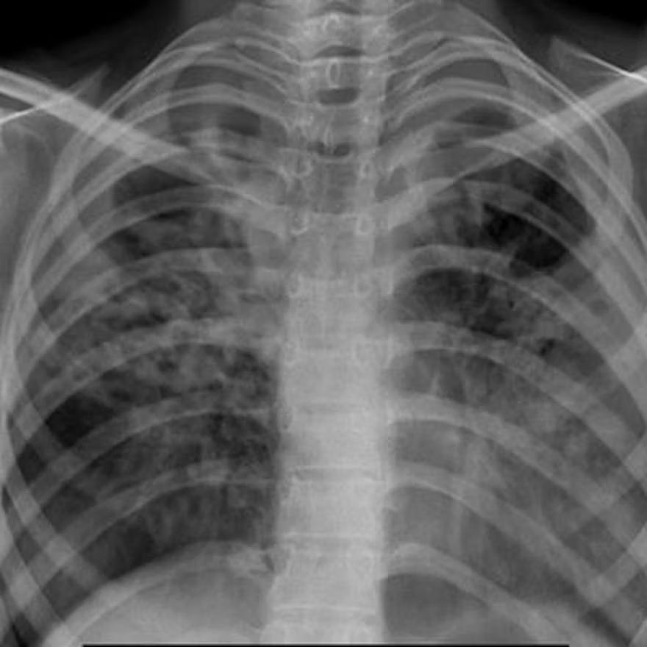

Slide 30
Congestive Heart Failure
Description: Heart's inability to pump blood effectively.
CXR Appearance:
Cardiac enlargement and pulmonary congestion (vascular redistribution).
Possible pleural effusion and Kerley B lines.
Guidance: Often requires correlation with clinical findings

